Slide 1
E-COMMERCE WEBSITE
"From Concept to Code: Developing Successful Online Store"

Slide 2

CONTRIBUTORS :
PRIYANSH ARORA
(2210990684)
PALAK BISHT
(2210990631)
PRATHAM KHATKAR
(2210990674)
PRANAV MANGAL
(2210990995)

Slide 3
TABLE OF CONTENT :
Introduction
Objectives
Problem Statement
Market Competitors
Features
Upcoming Features
Technical Stack
Technical Nodes
Source Code

Slide 4
INTRODUCTION
This project focuses on developing the back end of an e-commerce website. The back end is crucial for managing the server, database, and application logic, ensuring seamless operations for an online store.

Slide 5
OBJECTIVE
User-Friendly Interface
Ensure Security and Trust
Scalability and Performance
Build Brand Awareness
Adapt to Technological Trends

Slide 6
PROBLEM STATEMENT
To expand the brand's market presence, there is a need to create an e-commerce website that showcases the product range, facilitates online purchases
Provide a seamless shopping experience.
The website must be visually appealing, easy to navigate, secure for transactions, and capable of handling customer inquiries and orders efficiently.

Slide 7

MARKET COMPETITOR
Zappos
Foot Locker
StockX
ASOS

Slide 8
FEATURES
User – Friendly Interface
Data of SignIn and SignUp is saved
Password Encrypted

Slide 9
UPCOMING FEATURES
Cart Function
Subscribing to mail for daily updates

Slide 10
TECHNOLOGY STACK
FRONT END : HTML , CSS , JS
BACK END : NODE.JS , EXPRESS.JS
DATABASE : MONGODB
OTHER-TOOL : VERSION CONTROL(GIT)

Slide 11
TECHNICAL NODES
Subject / Area / Topic | Technical Nodes
MongoDB | NoSQL database for storing product information, user data, orders, and other relevant data.
Express.js | Web application framework for Node.js that simplifies server-side development
React.js | Frontend library for building user interfaces.
Javascript | JavaScript runtime environment that allows server-side execution of JavaScript code.
Payment Integration | Use payment gateways like Razor pay or PayPal for processing transactions.
Responsive Design | Use CSS frameworks like Tailwind for styling

Slide 12
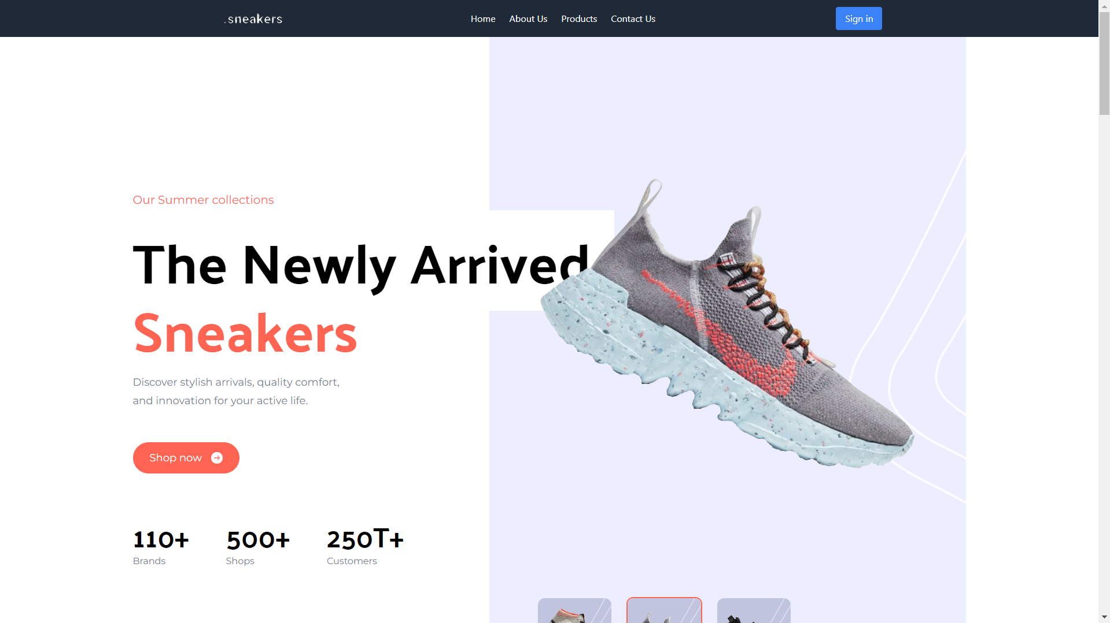
Source Code
HERO AREA

Slide 13
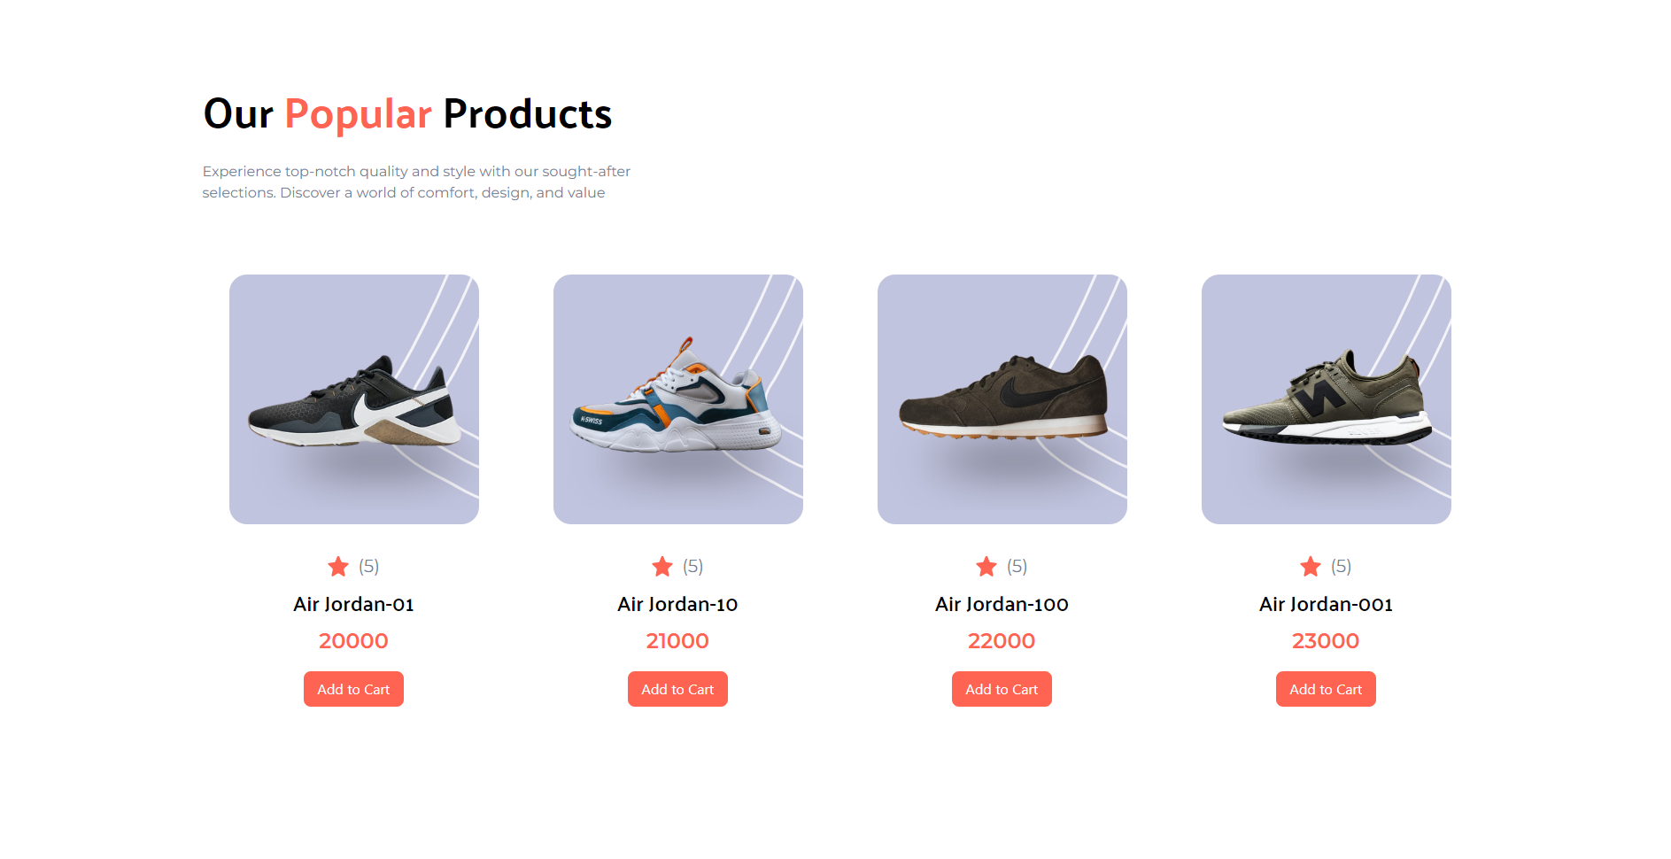
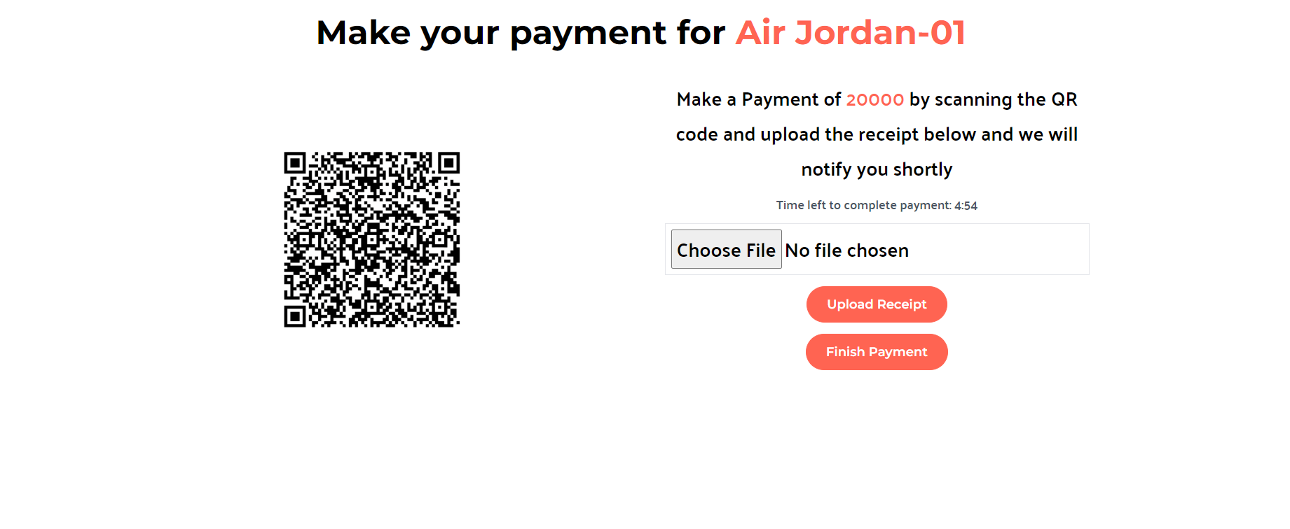
POPULAR PRODUCTS
PAYMENT AREA

Slide 14
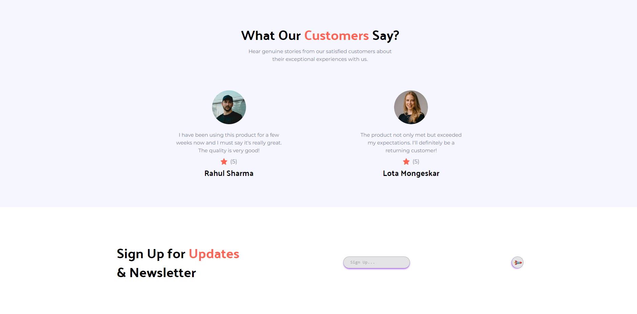
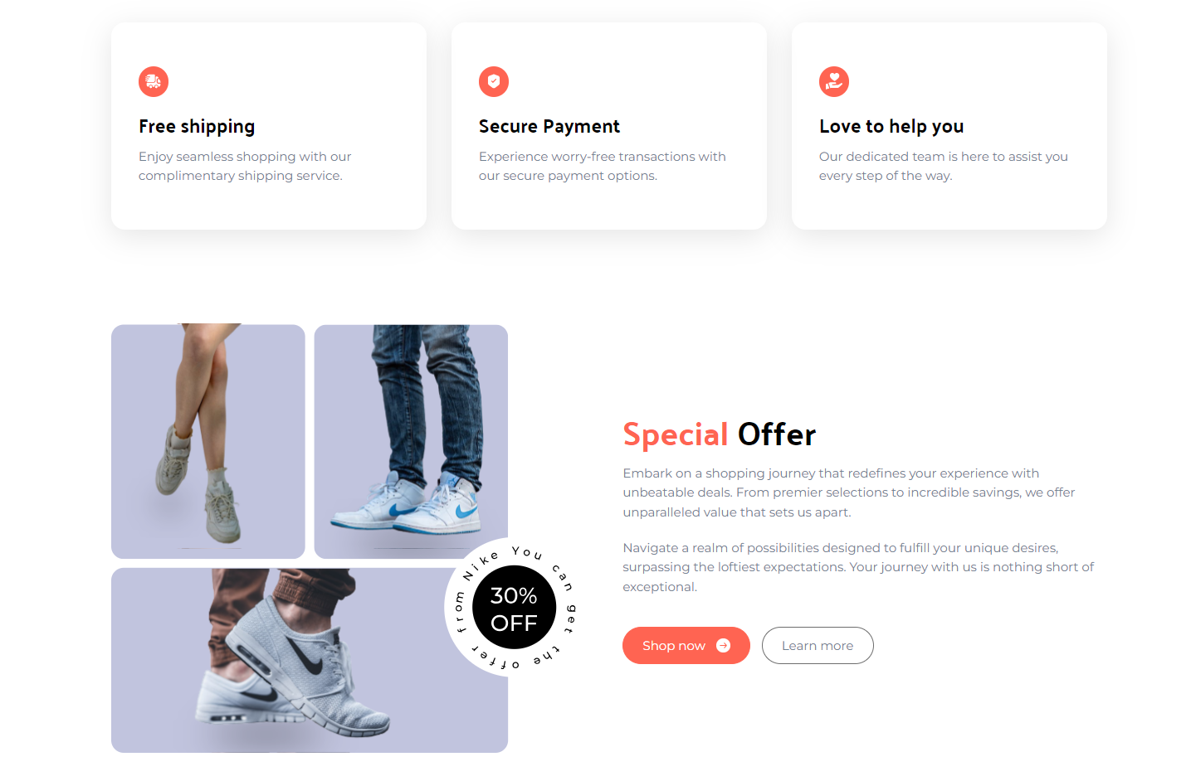
CUSTOMER REVIEW
AND SUBSCRIBE
OFFER
AREA

Slide 15
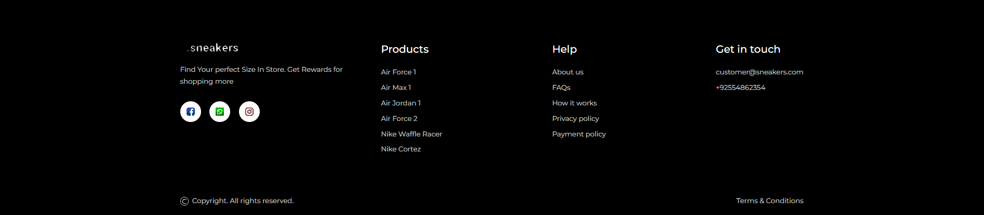
FOOTER

Slide 16


